Slide 1
Chapter One
Introduction to Data Structures and Algorithms

Slide 2
Introduction
A program
A set of instruction which is written in to solve a problem.
A solution to a problem actually consists of two things:
    A way to organize the data
    Sequence of steps to solve the problem
The way data are organized in a computers
memory is said to be Data Structure.
The sequence of computational steps to solve a problem is said to be an Algorithm.
Therefore, a program is Data structures plus Algorithm.

Slide 3
Introduction…
Data structures are used to model the world or part of the world. How?
  The value held by a data structure represents some specific characteristic of the world.
  The characteristic being modeled restricts the possible values held by a data structure and the operations to be performed on the data structure.
The first step to solve the problem is obtaining
ones own abstract view, or model, of the problem.
This process of modeling is called abstraction.

Slide 4
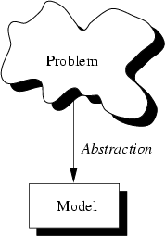
Introduction…
The model defines an abstract view to the problem.
The model should only focus on problem related stuff

Slide 5
Abstraction
Is a process of classifying characteristics as relevant and irrelevant for the particular purpose at hand and ignoring the irrelevant ones.
Example: model students of A University.
  Relevant:
  Char Name[15];
  Char ID[11];
  Char Dept[20];
  int Age, year;
  Non relevant
  float hieght, weight;

Slide 6
Abstraction…
Using the model, a programmer tries to define the properties of the problem.
These properties include
  The data which are affected and
  The operations that are involved in the problem
An entity with the properties just described is called an abstract data type (ADT).

Slide 7
Abstract Data Types
Consists of data to be stored and operations supported on them.
Is a specification that describes a data set and the
operation on that data.
The ADT specifies:
  What data is stored.
  What operations can be done on the data.
Does not specify how to store or how to implement the operation.
Is independent of any programming language

Slide 8
Abstract Data Types…
Example: ADT employees of an organization:
This ADT stores employees with their relevant attributes and discarding irrelevant attributes.
Relevant:- Name, ID, Sex, Age, Salary, Dept, Address
Non Relevant :- weight, color, height
This ADT supports hiring, firing, retiring, …
  operations.

Slide 9
Data Structure
In Contrast a data structure is a language construct
that the programmer has defined in order to
implement an abstract data type.
What is the purpose of data structures in programs?
  Data structures are used to model a problem.
Example:
struct Student_Record
{
char name[20];
char ID_NO[10];
char Department[10];
int age;
};

Slide 10
Data Structure…
Attributes of each variable:
  Name: Textual label.
  Address: Location in memory.
  Scope: Visibility in statements of a program.
  Type: Set of values that can be stored + set of operations that can be performed.
  Size: The amount of storage required to represent the variable.
  Life time: The time interval during execution of a program while the variable exists.

Slide 11
Algorithm
Is a concise specification of an operation for solving
a problem.
Is a well-defined computational procedure that takes
some value or a set of values as input and produces
some value or a set of values as output.
Inputs Algorithm Outputs
An algorithm is a specification of a behavioral
process. It consists of a finite set of instructions that
govern behavior step-by-step.
Is part of what constitutes a data structure

Slide 12
Algorithm…
Data structures model the static part of the world. They are unchanging while the world is changing.
In order to model the dynamic part of the world we need to work with algorithms.
Algorithms are the dynamic part of a program’s world model.
An algorithm transforms data structures from one state to another state.

Slide 13
Algorithm…
What is the purpose of algorithms in programs?
  Take values as input.
  Example: cin>>age;
  Change the values held by data structures.
  Example: age=age+1;
  Change the organization of the data structure:
  Example:
  Sort students by name
  Produce outputs:
  Example: Display student’s information

Slide 14
Algorithm…
The quality of a data structure is related to its ability to successfully model the characteristics of the world (problem).
Similarly, the quality of an algorithm is related to its ability to successfully simulate the changes in the world.
However, the quality of data structure and algorithms is determined by their ability to work together well.
Generally speaking, correct data structures lead to simple and efficient algorithms.
And correct algorithms lead to accurate and efficient data structures.

Slide 15
Properties of Algorithms
1. Finiteness:
  Algorithm must complete after a finite number of steps.
  Algorithm should have a finite number of steps.
Example of Finite Steps
int i=0;
while(i<10)
{
cout<< i;
i++;
}
Example of Infinite Steps
while(true)
{
cout<<“Hello”;
}

Slide 16
2. Definiteness (Absence of ambiguity):
  Each step must be clearly defined, having
  one and only one interpretation.
  At each point in computation, one should be
  able to tell exactly what happens next.
3. Sequential:
  Each step must have a uniquely defined
  preceding and succeeding step.
  The first step (start step) and last step (halt step)
  must be clearly noted.

Slide 17
4. Feasibility:
  It must be possible to perform each instruction.
  Each instruction should have possibility to be
  executed.
a) for(int i=0; i<0; i++)
{
cout<< i; // there is no possibility that this
} //statement to be executed.
b) if(5>7)
{
cout<<“hello”; // not executed.
}

Slide 18
5. Correctness:
  It must compute correct answer for all possible legal inputs.
  The output should be as expected and required and correct.
6. Language Independence:
  It must not depend on any one programming
  language.
7. Completeness:
  It must solve the problem completely.

Slide 19
8. Effectiveness:
  Doing the right thing. It should yield the correct result all the time for all of the possible cases.
9. Efficiency:
  It must solve with the least amount of computational resources such as time and space.
  Producing an output as per the requirement
  within the given resources (constraints).
Example: Write a program that takes a number and
displays the square of the number.
1) int x;
cin>>x;
cout<<x*x;
2) int x,y;
cin>>x;
y=x*x;
cout<<y;

Slide 20
Example:
Write a program that takes two numbers and displays the sum of the two.
All are effective but with different efficiencies.
Program a
cin>>a;
cin>>b;
sum= a+b;
cout<<sum;
Program b
cin>>a;
cin>>b;
a= a+b;
cout<<a;
Program c (the most efficient)
cin>>a;
cin>>b;
cout<<a+b;

Slide 21
10. Input/output:
  There must be a specified number of input
  values, and one or more result values.
  Zero or more inputs and one or more outputs.
11. Precision:
  The result should always be the same if the algorithm is given identical input.
12. Simplicity:
  A good general rule is that each step should carry out one logical step.
    What is simple to one processor may not be simple to another.

Slide 22
13. Levels of abstraction:
  Used to organize the ideas expressed in algorithms.
    Used to hide the details of a given activity and refer to just a name for those details.
    The simple (detailed) instructions are hidden inside modules.
    Well-designed algorithms are organized in terms of levels of abstraction.

Slide 23
Algorithm Analysis
Algorithm analysis refers to the process of determining how much computing time and storage that algorithms will require.
In other words, it’s a process of predicting the resource requirement of algorithms in a given environment.
In order to solve a problem, there are many possible algorithms.
One has to be able to choose the best algorithm for the problem at hand using some scientific method.

Slide 24
To classify some data structures and algorithms as good:
  we need precise ways of analyzing them in terms of resource requirement.
  The main resources are:
    Running Time
    Memory Usage
    Communication Bandwidth
Note: Running time is the most important since computational time is the most precious resource in most problem domains.

Slide 25
There are two approaches to measure the efficiency of algorithms: Empirical and Theoretical
1. Empirical
  based on the total running time of the program.
  Uses actual system clock time.
Example:
t1= initial time before the program starts
for(int i=0; i<=10; i++)
cout<<i;
t2 = final time after the execution of the program is finished
Running time taken by the above algorithm or
Total Time = t2-t1;

Slide 26
It is difficult to determine efficiency of algorithms using this approach, because clock-time can vary based on many factors.
For example:
a) Processor speed of the computer
1.78GHz 2.12GHz
10s <10s
b) Current processor load
    Only the work 10s
    With printing 15s
    With printing & browsing the internet >15s

Slide 27
c) Specific data for a particular run of the program
    Input size, Input properties
    t1
for(int i=0; i<=n; i++)
cout<<i;
t2
T=t2-t1;
For n=100, T>=0.5s
n=1000, T>0.5s
d) Operating System
    Multitasking Vs Single tasking
    Internal structure

Slide 28
2. Theoretical
  Determining the quantity of resources required
  using mathematical concept.
  Analyze an algorithm according to the number of basic operations (time units) required, rather than according to an absolute amount of time involved.
We use theoretical approach to determine the efficiency of algorithm because:
  The number of operation will not vary under
  different conditions.
  It helps us to have a meaningful measure that
  permits comparison of algorithms independent
  of operating platform.
  It helps to determine the complexity of algorithm.

Slide 29
Complexity Analysis
Complexity Analysis is the systematic study of the cost of computation, measured either in:
  Time units
  Operations performed, or
  The amount of storage space required.
Two important ways to characterize the effectiveness of an algorithm are its:
Space Complexity and
Time Complexity.

Slide 30
Time Complexity:
Determine the approximate amount of time (number of operations) required to solve a problem of size n.
  The limiting behavior of time complexity as size increases is called the Asymptotic Time Complexity.
Space Complexity:
Determine the approximate memory required to solve a problem of size n.
  The limiting behavior of space complexity as size increases is called the Asymptotic Space Complexity.

Slide 31
Asymptotic Complexity of an algorithm determines the size of problems that can be solved by the algorithm.
Factors affecting the running time of a program:
  CPU type (80286, 80386, 80486, Pentium I---IV)
  Memory used, Computer used, Programming Language - C (fastest), C++ (faster), Java (fast)
  C is relatively faster than Java, because C is relatively
  nearer to Machine language. So, Java takes relatively
  larger amount of time for interpreting or translation
  to machine code.
  Algorithm used and Input size
Note: Important factors for this course are
Input size and Algorithm used.

Slide 32
Complexity analysis involves two distinct phases:
  Algorithm Analysis: Analysis of the algorithm or data structure to produce a function T(n) that describes the algorithm in terms of the operations performed in order to measure the complexity of the algorithm.
Example: Suppose we have hardware capable of executing 10⁶ instructions per second. How long would it take to execute an algorithm whose complexity function is T(n)=2n² on an input size of n=10⁸?

Slide 33
Solution: T(n)= 2n²=2(10⁸)² = 2*10¹⁶
Running time=T(10⁸)/10⁶=2*10¹⁶/10⁶=2*10¹⁰
seconds.
Order of Magnitude Analysis: Analysis of the
function T (n) to determine the general complexity
category to which it belongs.
There is no generally accepted set of rules for algorithm analysis.
However, an exact count of operations is commonly used.
To count the number of operations we can use the following Analysis Rule.

Slide 34
Analysis Rules:
1. Assume an arbitrary time unit.
2. Execution of one of the following operations
takes time 1 unit:
  Assignment Operation, Example: i=0;
  Single Input/Output Operation
  Example: cin>>a;
  cout<<“hello”;
  Single Boolean Operations, Example: i>=10
  Single Arithmetic Operations, Example: a+b;
  Function Return, Example: return sum;
3. Running time of a selection statement (if, switch) is the time for the condition evaluation plus the maximum of the running times for the individual clauses in the selection.

Slide 35
Example: int x;
int sum=0;
if(a>b)
{
sum= a+b;
cout<<sum;
}
else
{
cout<<b;
}
T(n) = 1 +1+max(3,1) = 5

Slide 36
4. Loop statements:
  The running time for the statements inside the loop * number of iterations + time for setup(1) + time for checking (number of iteration + 1) + time for update (number of iteration)
  The total running time of statements inside a group of nested loops is the running time of the statements * the product of the sizes of all the loops.
  For nested loops, analyze inside out.
  Always assume that the loop executes the maximum number of iterations possible. (Why?)
      Because we are interested in the worst case complexity.

Slide 37
5. Function call:
  1 for setup + the time for any parameter calculations + the time required for the execution of the function body.
Examples:
1)
int k=0,n;
cout<<“Enter an integer”;
cin>>n
for(int i=0;i<n; i++)
k++;
T(n)= 3+1+n+1+n+n=3n+5

Slide 38
2) int i=0;
while(i<n)
{
cout<<i;
i++;
}
int j=1;
while(j<=10)
{
cout<<j;
j++;
}
T(n) = 1+n+1+n+n+1+11+2(10)
= 3n+34

Slide 39
3)
int k=0;
for(int i=1 ; i<=n; i++)
for( int j=1; j<=n; j++)
k++;
T(n)=1+1+(n+1)+n+n(1+(n+1)+n+n)
= 2n+3+n(3n+2)
= 2n+3+3n²+2n
= 3n²+4n+3

Slide 40
4). int sum=0; for(i=1;i<=n;i++))
sum=sum+i;
T(n)=1+1+(n+1)+n+(1+1)n
=3+4n=O(n)
5). int counter(){
int a=0;
cout<<”Enter a number”;
cin>>n;
for(i=0;i<n;i++)
a=a+1;
return 0; }
T(n)=1+1+1+(1+n+1+n)+2n+1
=4n+6=O(n)

Slide 41
6). void func( ){
int x=0; int i=0; int j=1;
cout<<”Enter a number”;
cin>>n;
while(i<n){ i=i+1;
}
while(j<n){
j=j+1;
}
}
T(n)=1+1+1+1+1+n+1+2n+n+2(n-1)
= 6+4n+2n-2
=4+6n=O(n)

Slide 42
7). int sum(int n){
int s=0;
for(int i=1;i<=n;i++)
s=s+(i*i*i*i);
return s;
}
T(n)=1+(1+n+1+n+5n)+1
=7n+4=O(n)
8). int sum=0;
for(i=0;i<n;i++)
for(j=0;j<n;j++)
sum++;
T(n)=1+1+(n+1)+n+n*(1+(n+1)+n+n)
=3+2n+n²+2n+2n²
=3+2n+3n²+2n
=3n²+4n+3=O(n²)

Slide 43
Formal Approach to Analysis
In the above examples we have seen that analyzing Loop statements is so complex.
It can be simplified by using some formal approach in which case we can ignore initializations, loop controls, and updates.
Simple Loops: Formally
For loop can be translated to a summation.
The index and bounds of the summation are the same as the index and bounds of the for loop.

Slide 44

Suppose we count the number of additions that are done. There is 1 addition per iteration of the loop, hence n additions in total.

Slide 45
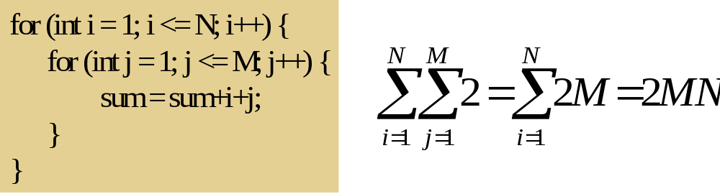
Nested Loops: Formally
Nested for loops translate into multiple summations, one for each For loop.

Slide 46
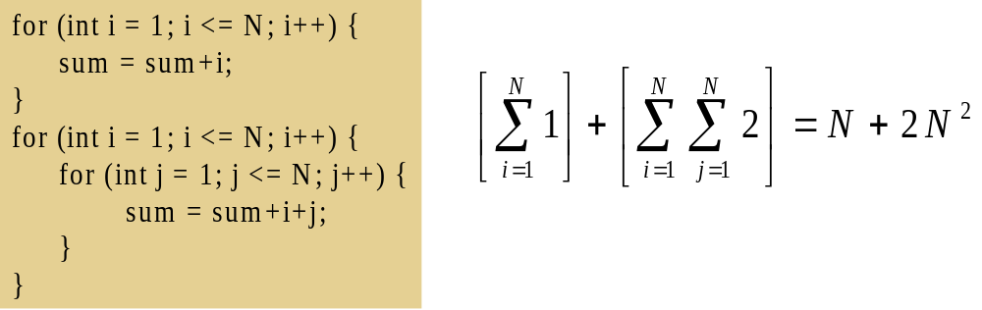
Consecutive Statements: Formally
Add the running times of the separate blocks of your code.

Slide 47
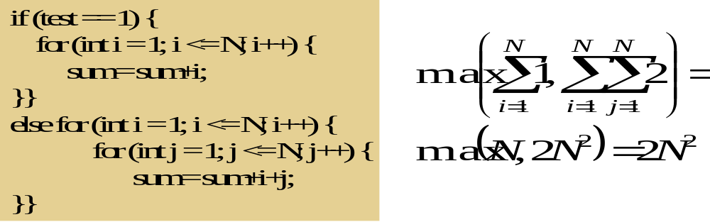
Conditionals: (Formally take maximum)
Example:

Slide 48
Recursive: Formally
Usually difficult to analyze.
Example: Factorial
long factorial(int n){
if(n<=1)
return 1;
else
return n*factorial(n-1);
}
T(n)=1+T(n-1)=2+T(n-2)=3+T(n-3)=-------
=n-1 (counting the number of multiplication)

Slide 49
Categories of Algorithm Analysis
Algorithms may be examined under different situations to correctly determine their efficiency for accurate comparison.
Best Case Analysis:
Assumes the input data are arranged in the most advantageous order for the algorithm.
Takes the smallest possible set of inputs.
Causes execution of the fewest number of statements.
Computes the lower bound of T(n), where T(n) is the complexity function.

Slide 50
Examples:
For sorting algorithm
  If the list is already sorted (data are arranged in the required order).
For searching algorithm
  If the desired item is located at first accessed position.

Slide 51
Worst Case Analysis:
Assumes the input data are arranged in the most disadvantageous order for the algorithm.
Takes the worst possible set of inputs.
Causes execution of the largest number of statements(operations).
Computes the upper bound of T(n) where T(n) is the complexity function.
Example:
While sorting, if the list is in opposite order.
While searching, if the desired item is located at
the last position or is missing.

Slide 52
Worst Case Analysis:
Worst case analysis is the most common analysis because:
  It provides the upper bound for all input (even for bad ones).
  Average case analysis is often difficult to determine and define.
  If situations are in their best case, no need to develop algorithms because data arrangements are in the best situation.
  Best case analysis can not be used to estimate complexity.
  We are interested in the worst case time since it provides a bound for all input-this is called the “Big-Oh” estimate.

Slide 53
Average Case Analysis:
Determine the average of the running time overall permutation of input data.
Takes an average set of inputs.
It also assumes random input size.
It causes average number of executions.
Computes the optimal bound of T(n) where T(n) is the complexity function.
Sometimes average cases are as bad as worst cases and as good as best cases.
Examples:
For sorting algorithms
  While sorting, considering any arrangement (order of input data).
For searching algorithms
  While searching, if the desired item is located at any location or is missing.

Slide 54
The study of algorithms includes:
  How to Design algorithms (Describing algorithms)
  How to Analyze algorithms (In terms of time and memory space)
  How to validate algorithms (for any input)
  How to express algorithms (Using programming language)
  How to test a program (debugging and maintaining)
But, in this course more focus will be given to Design and Analysis of algorithms.

Slide 55
Order of Magnitude
Refers to the rate at which the storage or time
grows as a function of problem size.
It is expressed in terms of its relationship to
some known functions.
This type of analysis is called Asymptotic
analysis.

Slide 56
Asymptotic Notations
Asymptotic Analysis is concerned with how the running time of an algorithm increases with the size of the input in the limit, as the size of the input increases without bound!
Asymptotic Analysis makes use of O (Big-Oh) , Ω (Big-Omega), θ (Theta), o (little-o), ω (little-omega) - notations in performance analysis and characterizing the complexity of an algorithm.
Note: The complexity of an algorithm is a numerical function of the size of the problem (instance or input size).

Slide 57
Types of Asymptotic Notations
Big-Oh Notation
Definition: We say f(n)=O(g(n)), if there are positive constants k and c, such that to the right of k, the value of f(n) always lies on or below c.g(n).
As n increases f(n) grows no faster than g(n).
It’s only concerned with what happens for very large values of n.
Describes the worst case analysis.
Gives an upper bound for a function to within a constant factor.

Slide 58
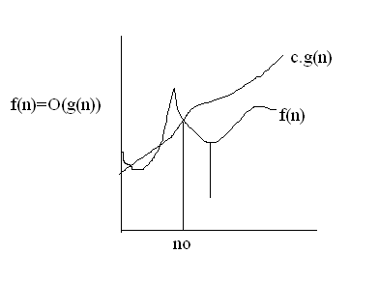
K
O-Notations are used to represent the amount of time an algorithm takes on the worst possible set of inputs, “Worst-Case”

Slide 59
Question-1
f(n)=10n+5 and g(n)=n.
Show that f(n) is O(g(n)). To show that f(n) is O(g(n)), we must show that there exist constants c and k such that f(n)<=c.g(n) for all n>=k.
10n+5<=c.n ➔ for all n>=k
let c=15, then show that 10n+5<=15n
  5<=5n or 1<=n
So, f(n)=10n+5<=15.g(n) for all n>=1
  (c=15, k=1), there exist two constants that satisfy the above constraints.

Slide 60
Question-2
f(n)=3n²+4n+1.
Show that f(n)=O(n²).
3n² <=3n² for all n>=1
4n<=4n² for all n>=1 and
1<=n² for all n>=1
3n²+4n+1<=3n²+4n²+n² for all n>=1
<=8n² for all n>=1
So, we have shown that f(n)<=8n² for all n>=1.
Therefore, f(n) is O(n²), (c=8, k=1), there exist two constants that satisfy the constraints.

Slide 61
Big-Omega (Ω)-Notation (Lower bound)
Definition: We write f(n)= Ω(g(n)) if there are positive constants k and c such that to the right of k the value of f(n) always lies on or above c.g(n).
As n increases f(n) grows no slower than g(n).
Describes the best case analysis.
Used to represent the amount of time the algorithm takes on the smallest possible set of inputs-“Best case”.
Example:
Find g(n) such that f(n) = Ω(g(n)) for f(n)=3n+5, g(n) = √n, c=1, k=1.
f(n)=3n+5=Ω(√n)

Slide 62
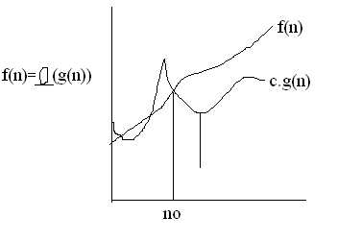
Big-Omega (Ω)-Notation (Lower bound)
Ω

Slide 63
3. Theta Notation (θ-Notation) (Optimal bound)
Definition: We say f(n)= θ(g(n)) if there exist positive constants n_{o}, c1 and c2 such that to the right of n_{o}, the value of f(n) always lies between c1.g(n) and c2.g(n) inclusive, i.e., c2.g(n)<=f(n)<=c1.g(n), for all n>=n_{o.}
As n increases f(n) grows as fast as g(n).
Describes the average case analysis.
To represent the amount of time the algorithm takes on an average set of inputs- “Average case”.
Example: Find g(n) such that f(n) = Θ(g(n)) for
f(n)=2n²+3
➔ n² ≤ 2n² ≤ 3n² ➔ c1=1, c2=3 and n_{o}=1
➔f(n) = Θ(g(n)).

Slide 64
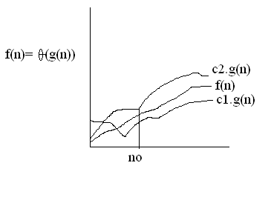
Theta Notation (θ-Notation) (Optimal bound)

Slide 65
4. Little-oh (small-oh) Notation
Definition: We say f(n)=o(g(n)), if there are positive constants n_{o} and c such that to the right of n_{o}, the value of f(n) lies below c.g(n).
As n increases, g(n) grows strictly faster than f(n).
Describes the worst case analysis.
Denotes an upper bound that is not asymptotically tight.
Big O-Notation denotes an upper bound that may or may not be asymptotically tight.
Example:
Find g(n) such that f(n) = o(g(n)) for f(n) = n²
n²<2n², for all n>1, ➔ k=1, c=2, g(n)=n²
n²< n³, g(n) = n³, f(n)=o(n³)
n²< n⁴ , g(n) =n⁴ , f(n)=o(n⁴)

Slide 66
5. Little-Omega (ω) notation
Definition: We write f(n)=ω(g(n)), if there are positive constants n_{o} and c such that to the right of n_{o}, the value of f(n) always lies above c.g(n).
As n increases f(n) grows strictly faster than g(n).
Describes the best case analysis.
Denotes a lower bound that is not asymptotically tight.
Big Ω-Notation denotes a lower bound that may or may not be asymptotically tight.
Example: Find g(n) such that f(n)=ω(g(n)) for f(n)=n²+3
g(n)=n, Since n² > n, c=1, k=2.
g(n)=√n, Since n² > √n, c=1, k=2, can also be solution.

Slide 67
Rules to estimate Big Oh of a given function
Pick the highest order.
Ignore the coefficient.
Example:
T(n)=3n + 5 ➔ O(n)
T(n)=3n²+4n+2 ➔ O(n²)
Some known functions encountered when analyzing algorithms. (Complexity category for Big-Oh).
See next slide ➔

Slide 68
Rule 1:
If T1(n)=O(f(n)) and T2(n)=O(g(n)), then
    T1(n)+T2(n)=max(O(f(n)),O(g(n))),
    T1(n)*T2(n)=O(f(n)*g(n))
Rule 2:
If T(n) is a polynomial of degree k, then T(n)=θ(n^{k}).
Rule 3:
log^{k} n=O(n) for any constant k. This tells us that logarithms grow very slowly.
  We can always determine the relative growth rates of two functions f(n) and g(n) by computing lim n->infinity f(n)/g(n).
  The limit can have four possible values.

Slide 69
  The limit is 0: This means that f(n)=o(g(n)).
  The limit is c≠0: This means that f(n)=θ(g(n)).
  The limit is infinity: This means that g(n)=o(f(n)).
  The limit oscillates: This means that there is no relation between f(n) and g(n).
Example:
n³ grows faster than n², so we can say that n²=O(n³) or n³=Ω(n²).
f(n)=n² and g(n)=2n² grow at the same rate, so both f(n)=O(g(n)) and f(n)=Ω(g(n)) are true.
If f(n)=2n², f(n)=O(n⁴), f(n)=O(n³), and f(n)=O(n²) are all correct, but the last option is the best answer.

Slide 70
T(n) | Complexity Category functions F(n) | Big-O
c, c is constant | 1 | C=O(1)
10logn + 5 | logn | T(n)=O(logn)
√n +2 | √n | T(n)=O(√n)
5n+3 | n | T(n)=O(n)
3nlogn+5n+2 | nlogn | T(n)=O(nlogn)
10n² +nlogn+1 | n² | T(n)=O(n²)
5n³ + 2n² + 5 | n³ | T(n)=O(n³)
2^{n}+n⁵+n+1 | 2^{n} | T(n)=O(2^{n})
7n!+2^{n}+n²+1 | n! | T(n)=O(n!)
8n^{n}+2^{n} +n² +3 | n^{n} | T(n)=O(n^{n})

Slide 71
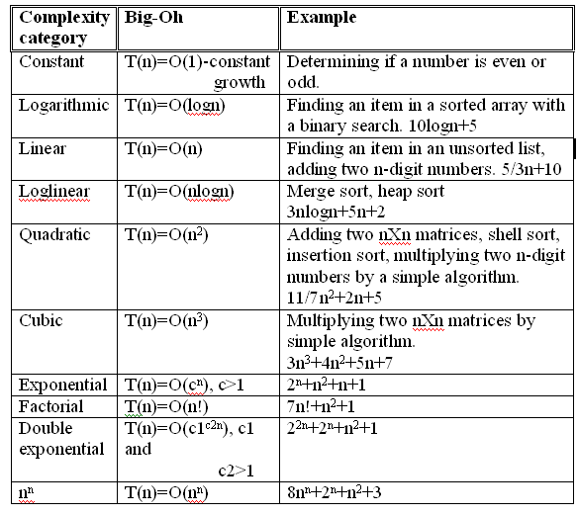

Slide 72
Arrangement of common functions by growth rate.
List of typical growth rates.
Function | Name
c | Constant
log N | Logarithmic
log² N | Log-squared
N | Linear
N log N | Log-Linear
N² | Quadratic
N³ | Cubic
2^{N} | Exponential

Slide 73
The order of the body statements of a given algorithm is very important in determining Big-Oh of the algorithm.
Example: Find Big-Oh of the following algorithm.
for( int i=1;i<=n; i++)
sum=sum + i;
T(n)=2*n=2n=O(n).
2. for(int i=1; i<=n; i++)
for(int j=1; j<=n; j++)
k++;
T(n)=1*n*n=n² = O(n²).

Slide 74


